Slide 1
Integration of AI in Thermal Power Plant Automation to Enhance Efficiency, Reliability, and Ensure Sustainability
Tamanna Akter
ID : 221-15-5298
Department of CSE
Daffodil International University
Dr. Sheak Rashed Haider Noori
Professor & Head
Department Of CSE
Daffodil International University

Slide 2
Outline
Introduction
Problem Statement
Motivation and Objective
Related Works
Comparison Between Existing Works
Gap Analysis
Proposed Methodology
Q & A

Slide 3
Introduction
Thermal power plants are crucial for energy generation.
Manual operations reduce efficiency.
AI can automate processes and optimize control.
Aim: Improve performance and reduce human intervention.

Slide 4
Problem Statement
Inefficient Control: Manual operations lead to delays and errors.
Lack of Prediction: No predictive models for key parameters.
Data Issues: Poor integration of plant data for decision-making.
Energy Wastage: Suboptimal resource use increases costs.
Research Goal:
Develop an AI-based system for real-time control and optimization in
thermal power plants.

Slide 5
Motivation and Objective
Motivation:
Efficiency concerns in manual operations.
Rising need for AI-based automation in power plants.
Desire to reduce human error and operational costs.
Objective:
Develop an AI system for thermal power plant automation.
Enhance operational efficiency and reliability.
Reduce human intervention in control processes.

Slide 6
Related Works
Author(s) | Method | Findings | Gap | Accuracy
Zhan et al. (2021) | Offline RL | Optimized combustion control. | Limited real-time application. | 88.2%
Kurkin et al. (2023) | Hybrid Quantum-Classical NN | Improved steam flow prediction. | No large-scale real-time validation. | 92.5%
Danish et al. (2023) | AI-based Forecasting Model | Enhanced energy generation efficiency. | Needs more complex models for multi-output. | 85.7%
KEPCO (2023) | AI Energy Management System | Optimized efficiency and reduced costs. | Limited real-time control integration. | 90.1%
Zhang et al. (2024) | Multi-Agent Machine Learning | Improved load prediction and optimization. | Challenges with multi-output predictions. | 87.3%

Slide 7
Comparison Between Existing Works
Aspect | My Work | Existing Works
Focus | AI-based control for thermal power plants | AI models for plant optimization, energy management, and load prediction
Approach | Machine Learning (ML), Real-time control system | Primarily simulation-based or offline models
Key Models Used | Random Forest, XGBoost, Decision Trees, MLP | Hybrid models, reinforcement learning, neural networks
Data Used | Real-time & historical data from BPDB | Mostly simulation data or historical data
Performance Metrics | R², MAE, RMSE, Cross-validation | Accuracy, Efficiency, Robustness
Gap Addressed | Integration of AI for real-time control and performance prediction | Lack of real-time control systems and multi-output prediction

Slide 8
Gap Analysis
Control System:
Simulation-based
Prediction:
Single-output
Model Variety:
Hybrid/Neural Networks
Data:
Simulated data
Integration:
imited real-world application
Regional Context:
Limited research in Bangladesh

Slide 9
Proposed Methodology
System Testing & Validation
Model Development
Data Collection
Real-Time Prediction Integration
Deployment & Monitoring
Data Preprocessing
Control & Automation

Slide 10
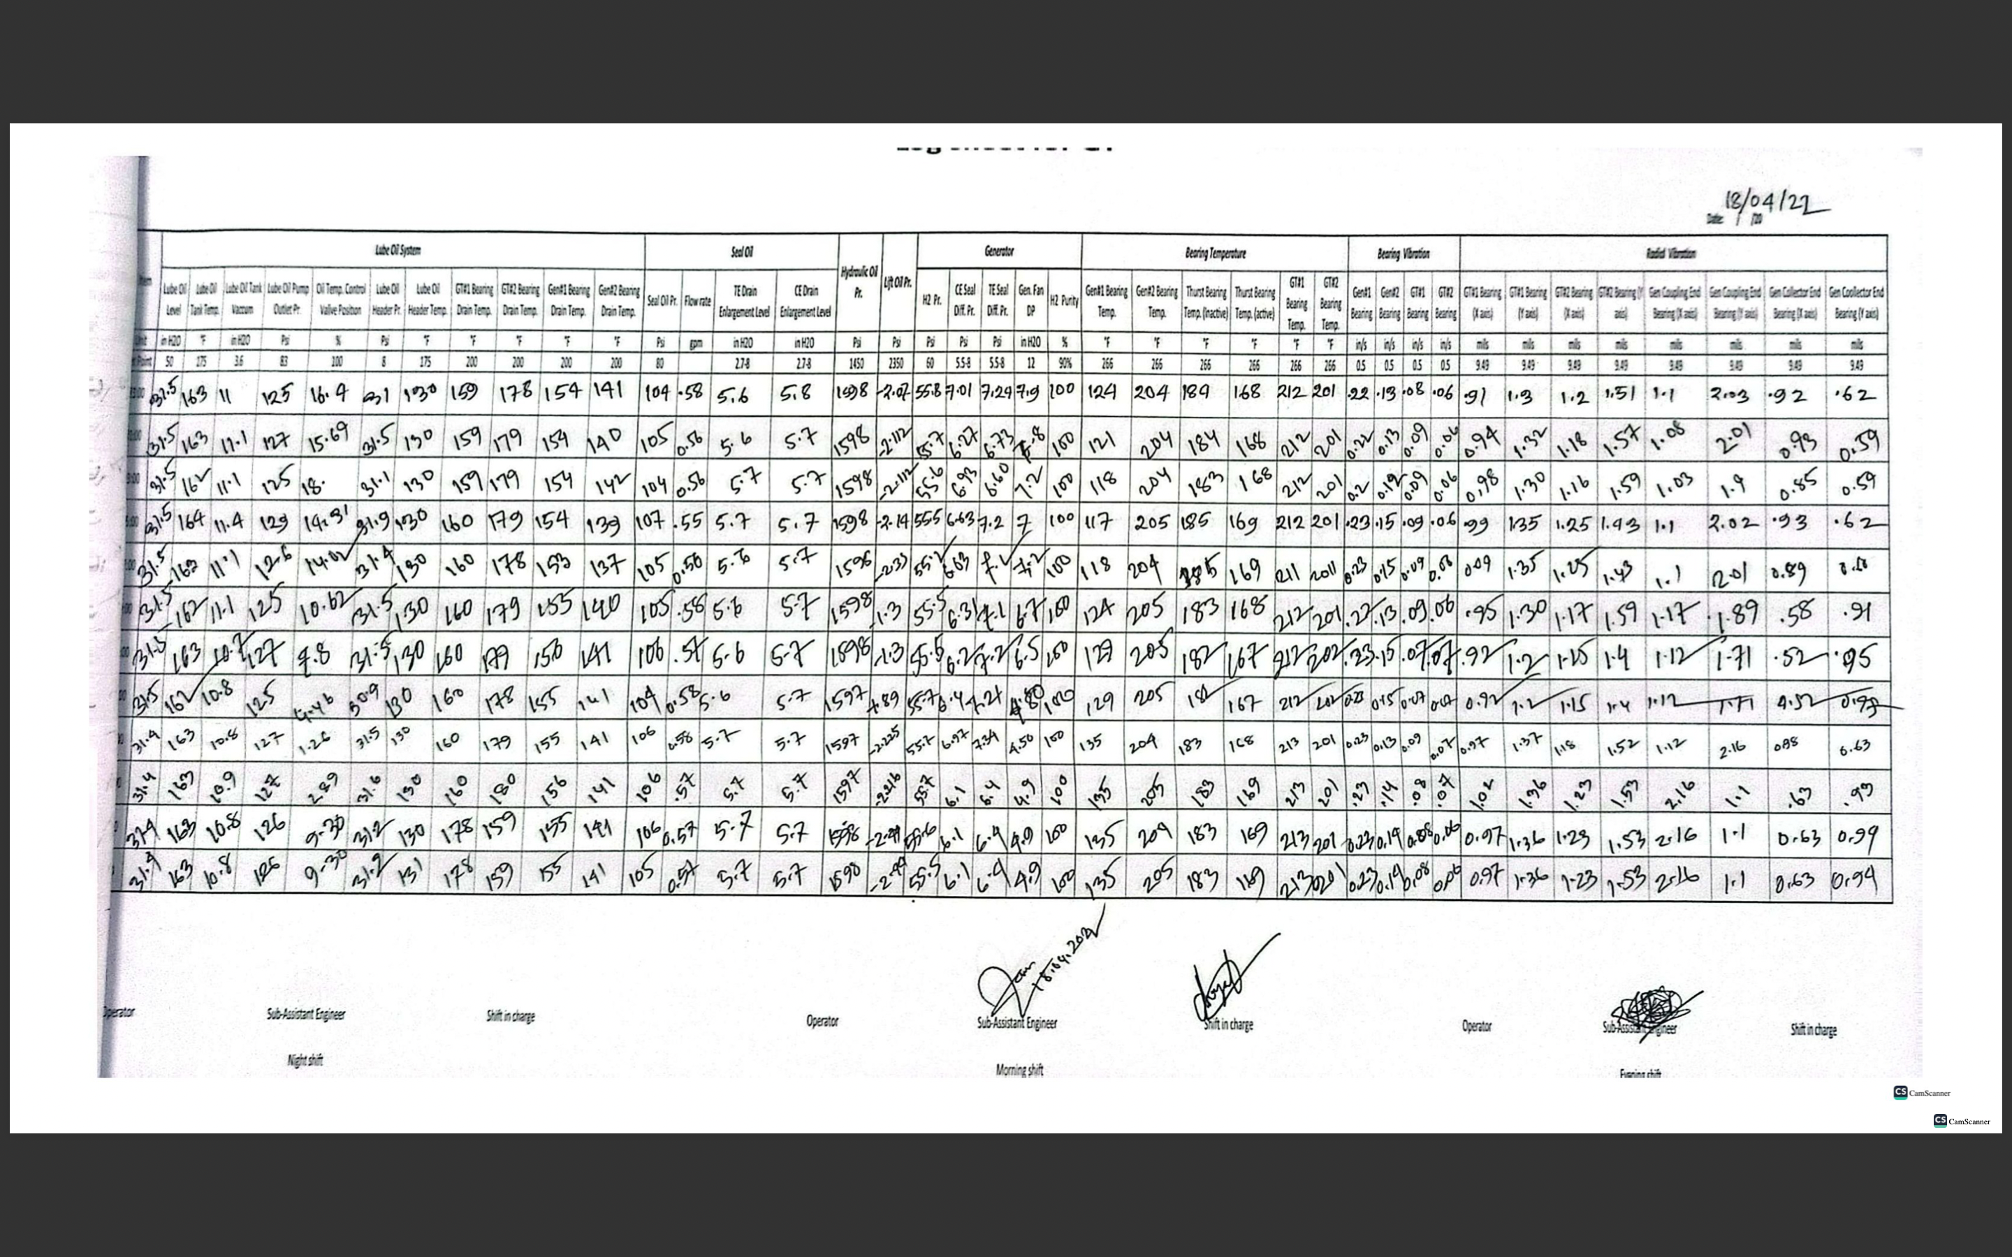
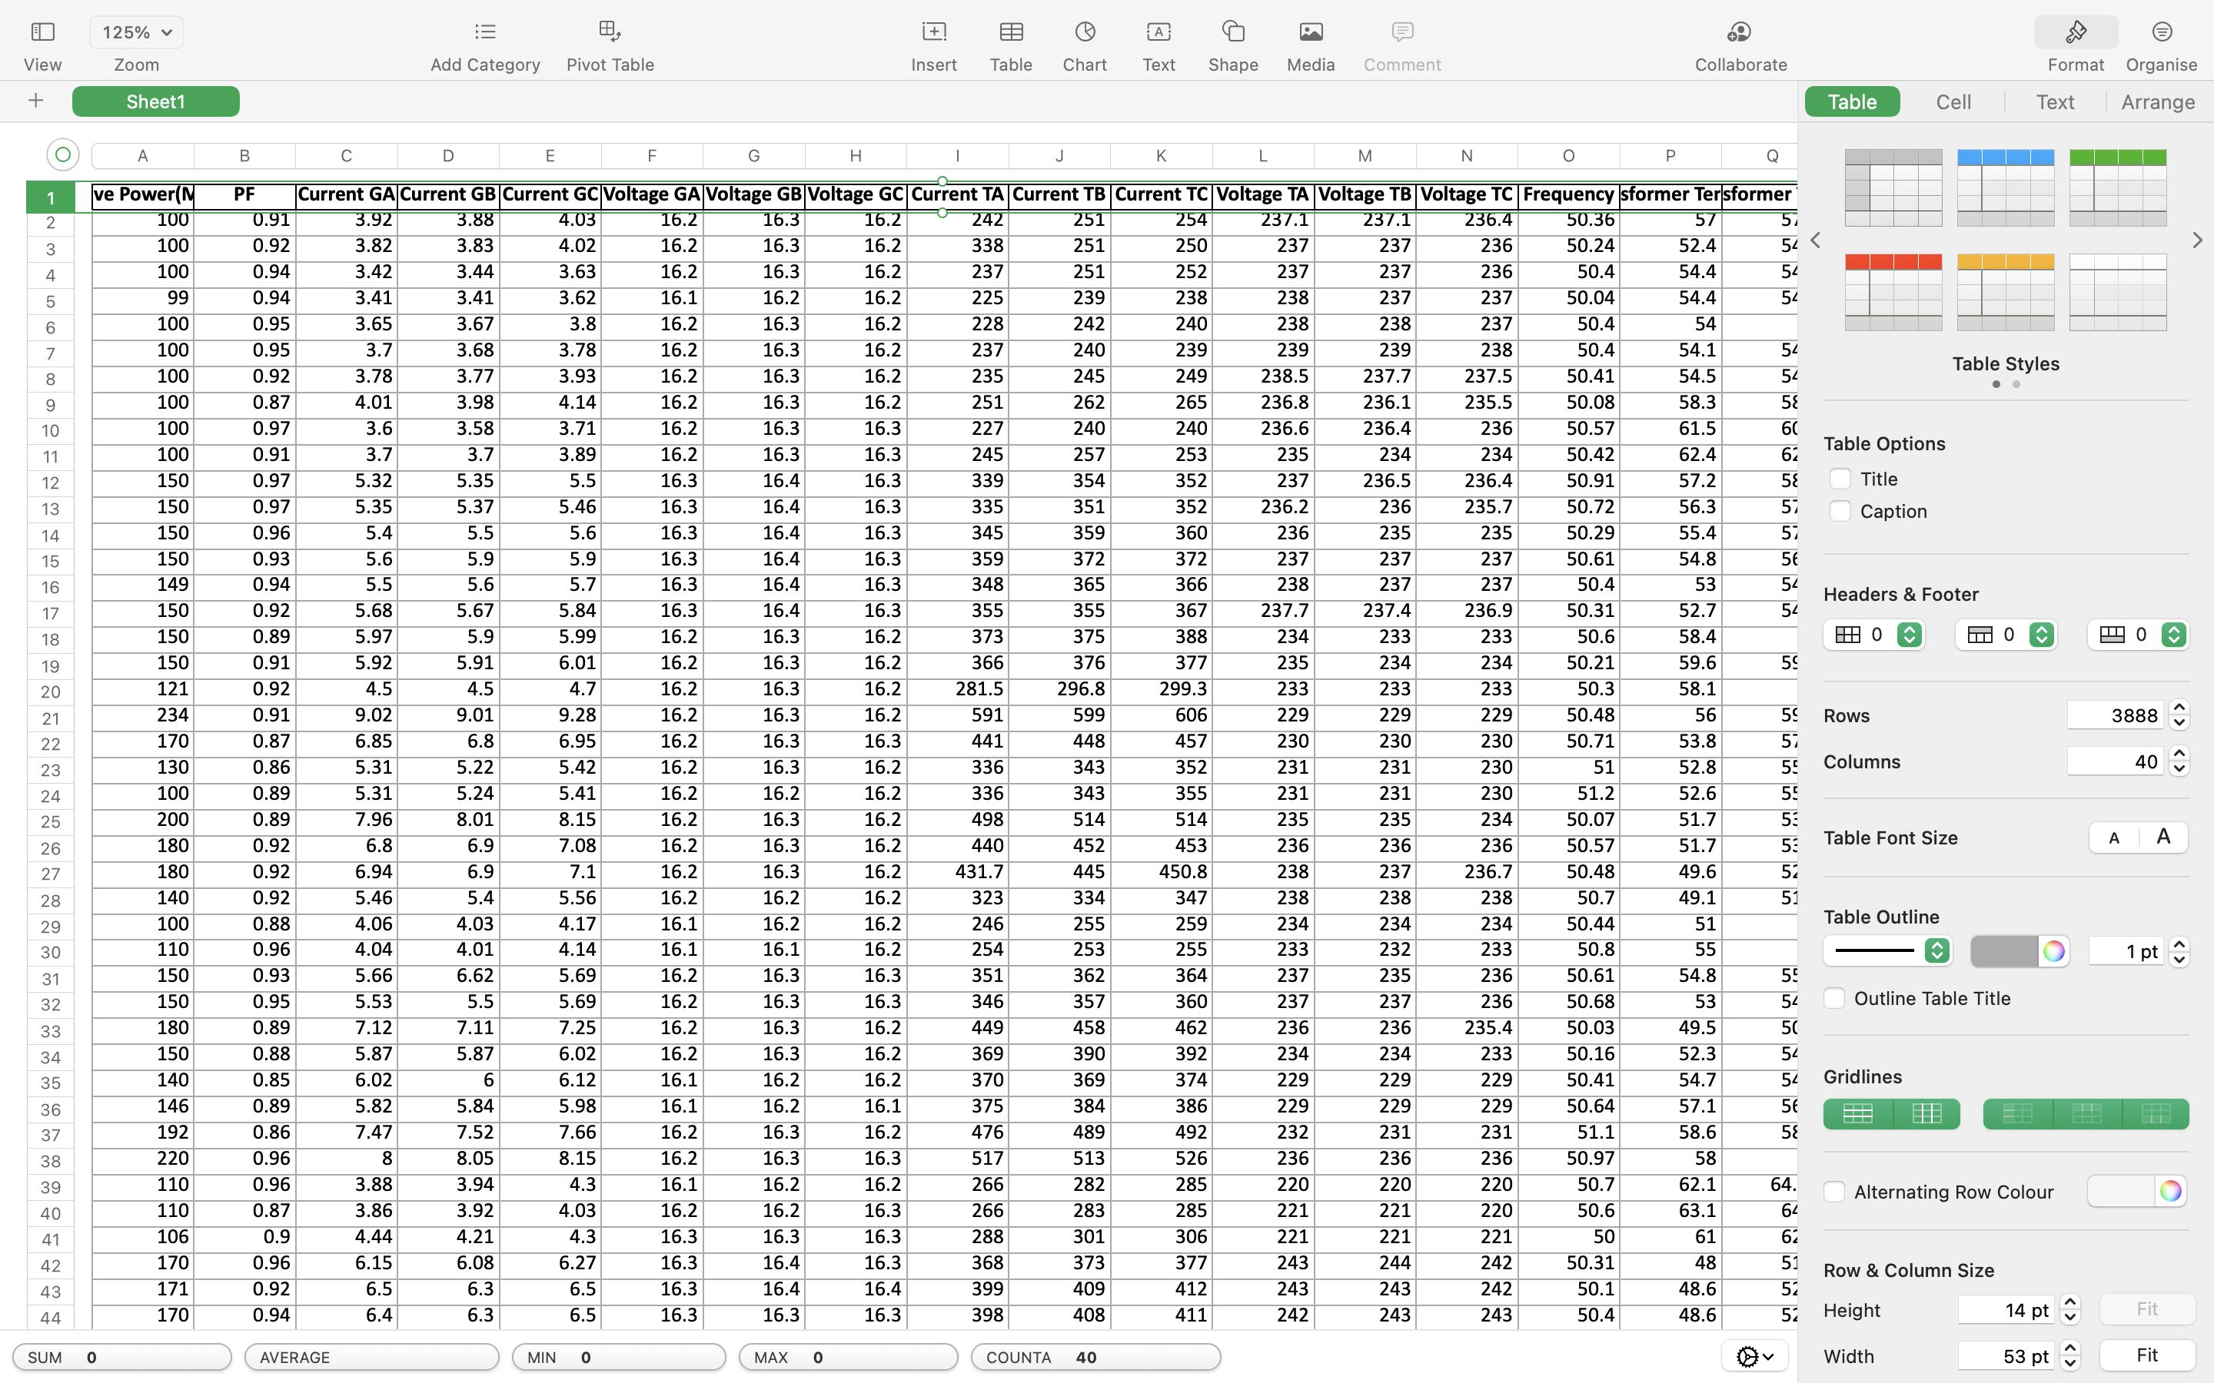
Dataset Overview
Logbook
Xcel Sheet

Slide 11
Results
Active Power Prediction
Model | MAE | MSE | RMSE | R² Score | Cross-Val R²
Linear Regression | 2.8520 | 18.8741 | 4.3444 | 0.9875 | 0.9864
Ridge Regression | 2.8162 | 19.0353 | 4.3629 | 0.9874 | 0.9871
Lasso Regression | 3.4032 | 31.1537 | 5.5816 | 0.9794 | 0.9755
Decision Tree | 0.0406 | 0.5393 | 0.7343 | 0.9996 | 0.9899
Random Forest | 0.0295 | 0.1066 | 0.3264 | 0.9999 | 0.9995
Gradient Boosting | 0.4744 | 0.5376 | 0.7332 | 0.9996 | 0.9995
XGBoost | 0.0393 | 0.1767 | 0.4204 | 0.9999 | 0.9993
KNN | 0.1771 | 3.3317 | 1.8253 | 0.9978 | 0.9985
SVR | 23.0952 | 785.0858 | 28.0194 | 0.4808 | 0.4839
MLP Regressor | 4.9328 | 49.6833 | 7.0486 | 0.9671 | 0.9593

Slide 12
Results
Multi-Feature Prediction
Model | MAE | RMSE | R² Score | Cross-Val R²
Random Forest | 0.1348 | 1.6581 | 0.9815 | 0.9681
XGBoost | 0.1511 | 1.6651 | 0.9814 | 0.9685
MLP | 3.0219 | 7.1986 | 0.2594 | 0.2328
SVR | 3.1517 | 7.7571 | 0.4724 | 0.4679
Linear Regression | 2.7298 | 6.8569 | 0.5285 | 0.5322
KNN | 0.1492 | 1.7984 | 0.9778 | 0.9635
Decision Tree | 0.1364 | 1.7355 | 0.9778 | 0.9640

Slide 13
Q & A

Slide 14
THANK YOU

